Slide 1
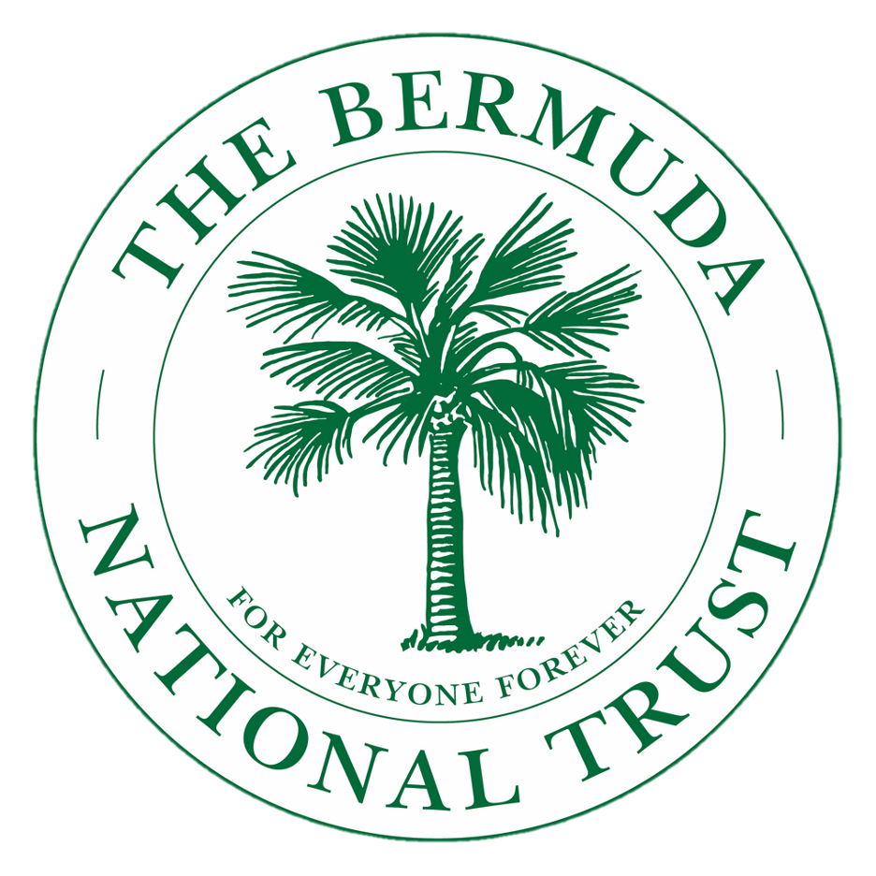
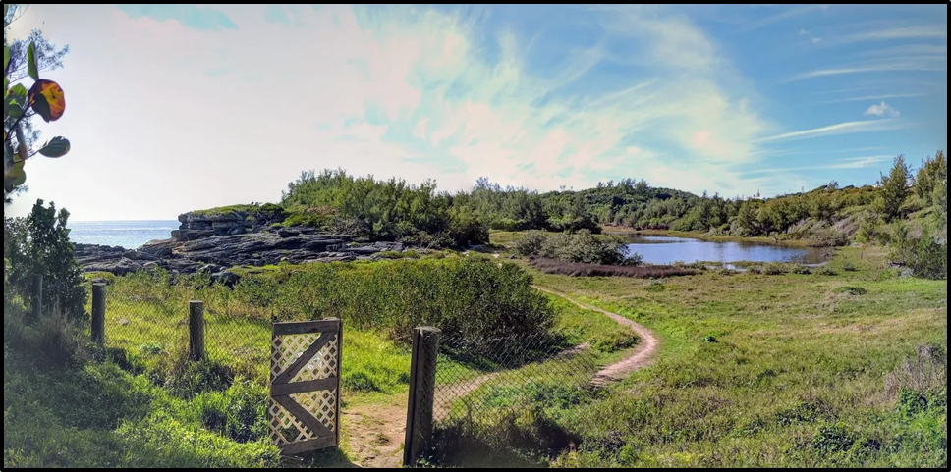
Children’s Nature Walk 2021
Photograph used with the kind permission of Emille Cossette
For everyone, forever.
Next Slide

Slide 2
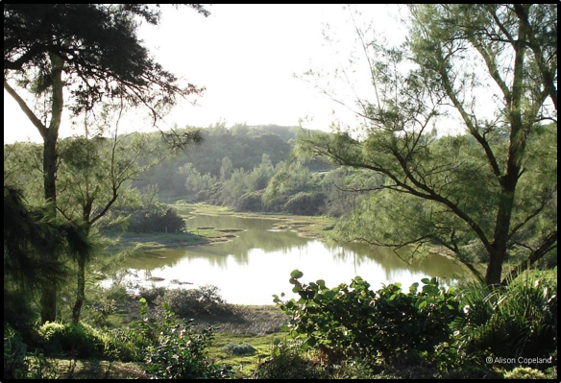
Did you know...?
Spittal Pond was established in 1954, with 64 acres of land,
in a joint venture between the Bermuda government (Parks Department) and the Bermuda National Trust.
Next Slide

Slide 3
Before You Start
We want you to learn all about how important Spittal Pond is to Bermuda’s natural and cultural heritage. We also want you to appreciate being here so that you might come back with family or friends to explore more.
There are a few simple rules to remember throughout your walk:
1. Keep to the paths, there are some dangerous areas, and we cannot have people walking on their own.
2. Please be respectful and quiet, we don’t want to scare the birds.
Have fun. The motto we like to use is, “Take only memories leave only footprints.” Q:What does that mean to you?
Next Slide

Slide 4
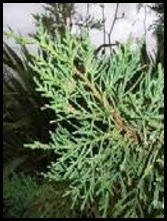
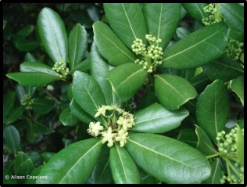
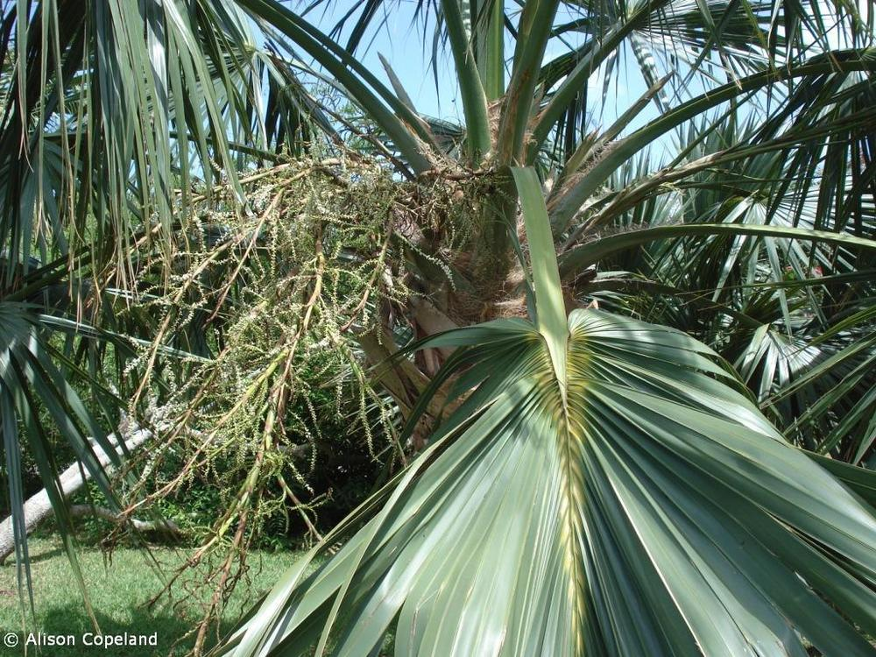
ON YOUR ARRIVAL
On your walk today, you will explore a variety of habitats for over 200 species of migrating birds.
Q: What is a habitat? A: A habitat is the natural home of an animal, plant or other living thing.
You will see native and endemic species. ‘Native’ plants or animals came without human assistance (all by themselves) and were found in Bermuda before people arrived. ‘Endemics’ are native plants or animals that have evolved into unique species and are found nowhere else in the world.
Q: What are Bermuda’s 3 endemic trees? A: Bermuda Cedar, Olivewood and Palmetto.
Click on the pictures to find out more about each endemic tree!
Click here for Station 1

Slide 5
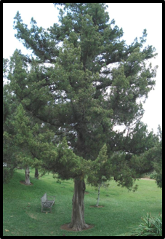
Bermuda Cedar
When Bermuda cedar trees became fully grown, the early settlers used the wood to build ships, houses and furniture, and used the berries to make wine. Q: Do you have any cedar furniture in your home?
The picture on the left shows the branches of the cedar tree. In the spring you can identify the male cedar as it produces pollen filled yellow cone-like flowers; the females have small flowers that become the characteristic berries. The blue-grey berries ripen and turn dark purple between September and December and provide an excellent source of food for birds.
Return

Slide 6
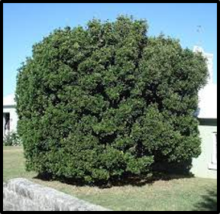
Bermuda Olivewood
The Bermuda Olivewood, also called Olivewood Bark grows to 8-14 m (25-45 feet) and develops a thick, smooth-barked trunk. The leaves are glossy on the top, with a toothed edge. New leaves at the tips of branches are bright green, while the older leaves further down the branch are darker green.
The Olivewood was one of the trees in the original forest of Bermuda. It would have been found scattered among other trees on sheltered valleys and inland hillsides. The early colonists used the bark of the Olivewood for tanning leather. As the sheltered valleys of Bermuda were cleared for agriculture, and invasive species were introduced, this tree became rare.
Olivewood flowers in late winter and spring. The small flowers are greenish white and occur in clusters at the tip of branches. The flowers are followed by yellowish green fruit that resemble small olives, hence the common name of this tree. The fruit ripen in the autumn.
Return

Slide 7
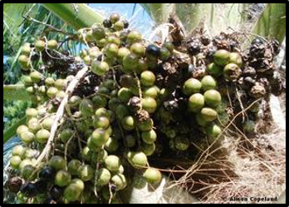
Bermuda Palmetto
The Bermuda Palmetto grows all over the island in upland and coastal forests and freshwater marsh habitats. It does well in most situations and habitats (except the saltiest) and makes a nice garden tree. Palmettos grow to 35 feet (10.5 m) high. The leaf stalk sticks out about halfway into the leaf in a V-shape. Also, the leaf stalk of the palmetto never has spines or thorns. They have an attractive bright yellow patch around the stalk in the middle of the leaf. The dark green leaves are quite firm and hold up well in Bermuda’s windy weather.
Palmettos produce sprays of small yellowish white flowers in the spring. The fragrant flowers are pollinated by insects and mature into large clusters of fruit. These are round, bright green berries which become purplish black as they ripen in the autumn. Each berry contains a single large seed. The fleshy fruit of the palmetto provides food for lots of birds and other animals, and they provide a habitat for insects and nesting material for birds.
Return

Slide 8
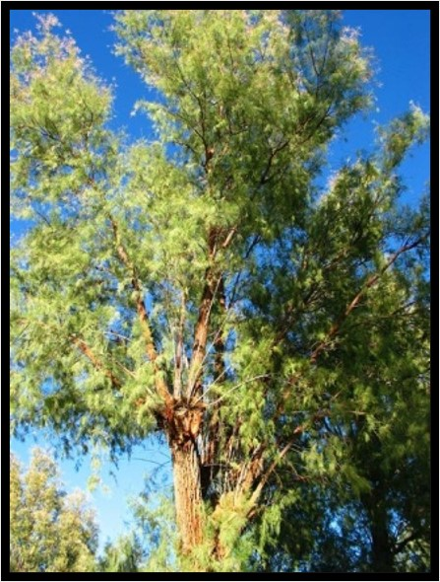
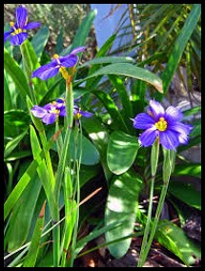
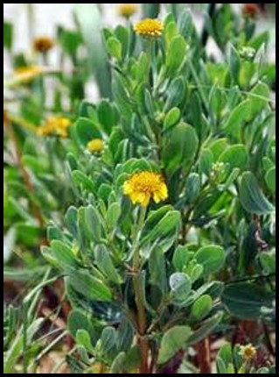
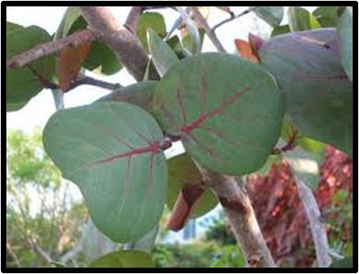
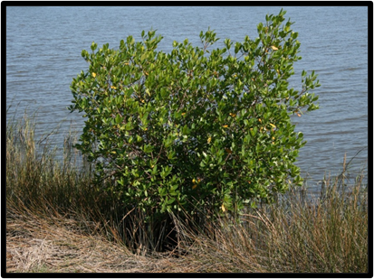
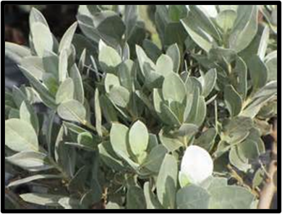
STATION 1 - INTRODUCTION
Watch Myles Darrell, Head of Natural Heritage for the Bermuda National Trust, talk about why Spittal Pond is such an important place in Bermuda. CLICK HERE FOR VIDEO.
ACTIVITY: After watching the video, head to Station 2. On your way, look around you. How many of these plant species can you see? Click on the picture to find out more about each one.
Click here for Station 2

Slide 9
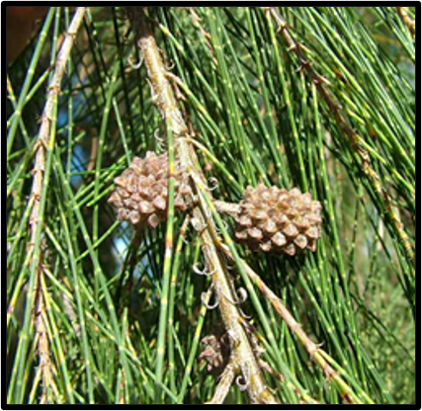
Casuarinas
Covering the hillside are Casuarinas or Australian Whistling Pines, imported to Bermuda to serve as a windbreak, following the destruction of cedar trees in the 1940s by an accidentally introduced scale insect. The image below shows casuarina berries that this tree produces. They begin bright green in colour and then dry as brown spiky cones and fall off the tree and land on the ground.
Return

Slide 10
Bermudiana
There are many Bermudianas on the hillsides around Spittal Pond, but we might not see them easily, as they normally flower between April and May. The Bermudiana is a member of the iris family, and it is Bermuda’s national flower. It has bright purple petals with a bright yellow centre. When it is not flowering, the plant appears as a cluster of bright green or greyish green, strap-like leaves. Bermudianas develop a three-part, dark seed pod in June and July. These break open to release lots of small, round, black seeds. Bermudianas can be easily grown by collecting the seeds.
The Bermudiana is quite hardy and can be found in a variety of habitats, from sandy beach dunes, to rocky shorelines, and coastal forest floors. It is also widely used as a garden plant.
Return

Slide 11
Sea Ox-eye
Another common plant in this area is the Sea Ox-eye. Both the waxy green leaves and the hairy grey leaves are special adaptations, which allow this plant to survive in areas that have little water. This native plant has bright yellow daisy-like flowers that bloom from spring to autumn.
Return

Slide 12
Buttonwood
Once you pass through the gate a native shrub called Buttonwood, grows on the left in this area and can live in very salty areas. It is sometimes referred to as the white mangrove. This plant has a thick leaf which helps to protect it from the salt spray coming off the ocean. The Buttonwood was important to early settlers as they used the bark for tanning leather.
Return

Slide 13
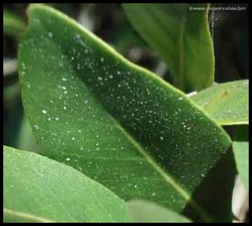
Black Mangrove
As you walk down alongside the pond you will see a few Black Mangrove trees close to the pond. They are salt tolerant and manage to thrive next to salt water. They have distinctive roots that grow up and out of the water for the plant to get oxygen. Look closely at the leaves, you may see salt crystals, which results as the mangrove drinks the water and expels (sweats) the salt taken in from the plant.
There are two types of mangroves that grow in Bermuda, both red and black mangroves. Black mangroves are the only variety found at Spittal Pond.
Return

Slide 14
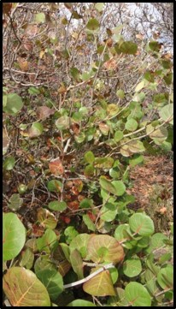
Bay Grape
You’ll also see some small Bay Grape Trees, which are native to Bermuda. The bay grape leaves (shown on the right) produce a fruit often made into jelly.
Return

Slide 15
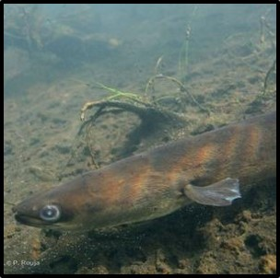
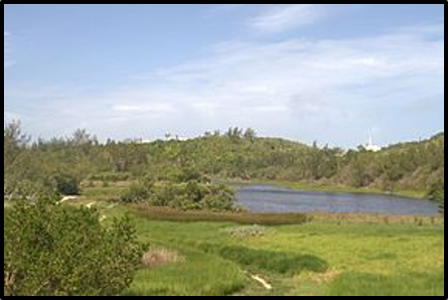
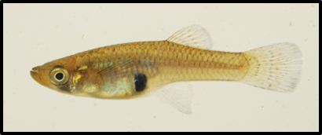
STATION 2 – POND EASTERN SIDE
Watch Dr Jamie Bacon from Bermuda Aquarium, Museum and Zoo talk about the pond ecology and the eels and the mosquito fish that live in the pond. CLICK HERE FOR VIDEO.
Q: In the video, Dr Bacon said Spittal Pond was the most important place in Bermuda, for what?
A: Migrating birds
Mosquito fish
American eel
Looking north across the main pond
Next slide

Slide 16
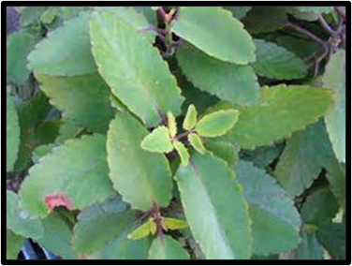
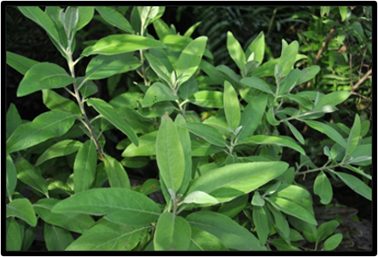
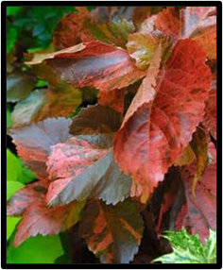
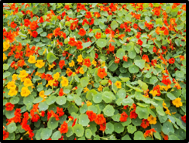
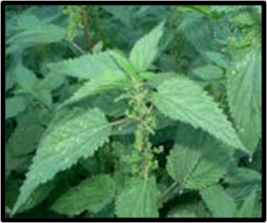
Walking to Station 3
Activity: On your walk to Station 3, see if you can spot any of these plants. Click on the pictures to find out more about each one.
You can play lots of fun games on your way around. How about playing “Give Me Five”?
Ask your child to name five species of flower or birds or trees!
Click here for Station 3

Slide 17
Flopper
Along the path is a plant called the Flopper. The flopper is now well established in Bermuda and gets its name ‘life plant’ by its ability to produce new plants from a single leaf. Notice its unique shaped leaf edges. It can be used as a medicinal plant for sore throats.
Return

Slide 18
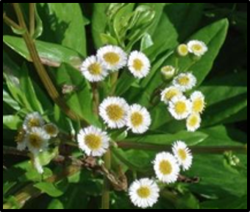
Darrell’s Fleabane
This is a native shrub found on upland hillsides and peat marshes. The flowers are followed by fluffy clumps of small seeds which are spread by the wind.
Darrell’s Fleabane grows in sandy soil in coastal areas of Bermuda, as well as rocky areas like road cuts and stone walls. It grows well when it is protected by other plants. Darrell’s Fleabane also does well when planted in rock gardens and coastal flowerbeds.
Return

Slide 19
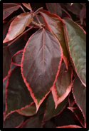
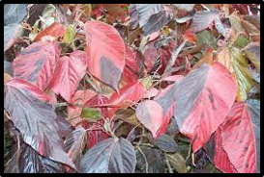
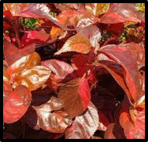
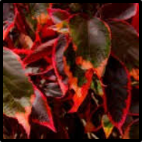
Match Me If You Can
This native Bermuda plant has a wonderful name, “Match-Me-If-You-Can”. It was used as a medicine in the past. Settlers would soak the leaves in vinegar or whiskey and wrap them over the body to relieve measles and fevers.
Q: Why do you think it’s called that?
A: No two leaves are the same.
Can you find two leaves that are similar?
Return

Slide 20
Nasturtium
Look for the colourful nasturtium plants. The petals are edible and taste peppery. The leaves are also edible and are packed with vitamin C!
Return

Slide 21
Stinging Nettle
Watch out for the stinging nettles!
Today, this plant is one of the most widely used in herbal medicine. Certainly the early settlers would have had knowledge of its uses. They would have boiled up the leaves and used the liquid to treat a huge amount of different illnesses – everything from the common cold to an upset tummy. If you do get stung, the best way to get rid of the sting is to wash the area in soap and water as soon as possible.
Return

Slide 22
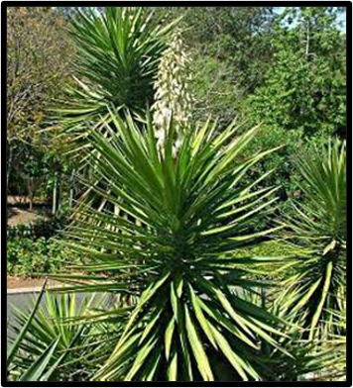
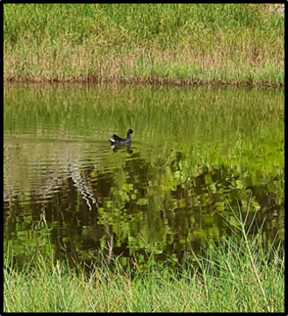
STATION 3 – THE SMALL POND
Watch Dr Alex Amat from Bermuda Aquarium, Museum and Zoo talk about the water in the small pond and see her experiment to discover how much oxygen the water is compared to the big pond. CLICK HERE FOR VIDEO.
Q: Which pond has more oxygen – the small pond or the big pond?
A: Small pond.
Can you see any of the species listed on the information board?
This pond is man-made, and a lot of the vegetation once here has been destroyed due to hurricane winds. If you are very quiet, you may see some special resident and migratory birds.
While you are standing in this area you can see a few Spanish Bayonets (pictured above) that are easily recognized. They have rigid ‘bayonet-like’ leaves with sharp points and a flower spike with numerous white flowers which bloom in the spring to autumn. Q: Do you know what a bayonet is? A: A type of sword that sits on the end of a rifle.
Next slide

Slide 23
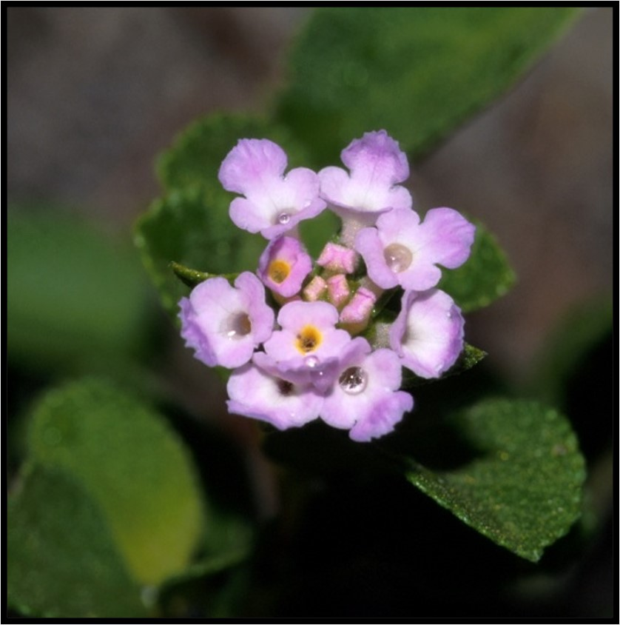
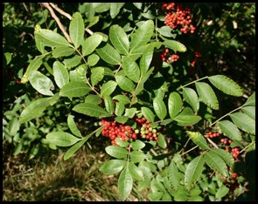
Walking to Station 4
Activity: On your walk to Station 4, see if you can spot any of these plants. Click on the pictures to find out more about each one.
Click here for Station 4

Slide 24
Common Sage or Lantana
Look for the Common Sage Bush or Lantana. It has small prickly leaves and clusters of small pink/purple flowers. Historians believe that the early settlers used the leaves to clean their teeth.
Q; What do you think medicine was like for the early settlers?
Q: What problems might they have faced?
Return

Slide 25
Brazil or Mexican Pepper
As you continue up the hill, you will see the invasive Brazil or Mexican Pepper trees. This plant produces bright red clusters of berries used in decorations at Christmas. The flowers serve as a source of honey for bees. Watch this plant from a distance as you may develop a skin rash.
Return

Slide 26
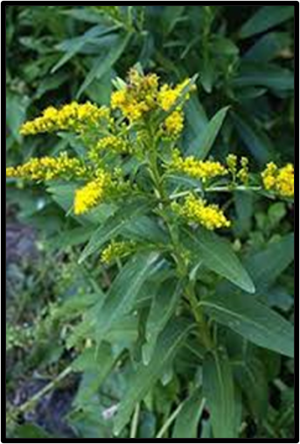
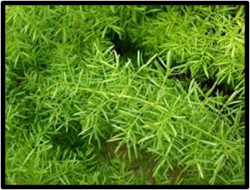
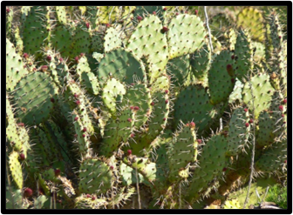
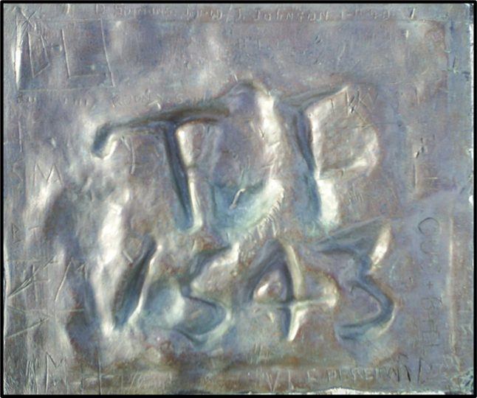
STATION 4 – PORTUGUESE ROCK
Watch Mr Rui De Sa, who is a lecturer at Bermuda College, tell the story of one of Bermuda’s most famous sites. Learn who may have carved out a date and letters onto a rock, one of the earliest pieces of evidence humans were in Bermuda. CLICK HERE FOR VIDEO.
Q: What would it have felt like to be shipwrecked in Bermuda in 1543? How would you have survived?
After listening to the story, walk to Station 5. On either side of the pathway down to Jeffery’s Cave you will see these plants. Click on the pictures to find out more about each one.
Click here for Station 5
Portuguese Rock – carving reads ‘RP 1543’

Slide 27
Seaside Goldenrod
The native Seaside Goldenrod also grows along the pathway and through the park. The yellow flower of this plant is a favourite source of nectar for Bermuda’s honeybees. (It blooms in late summer and early autumn).
Q: Why are bees such an important insect?
A: Bees pollinate food crops. Pollination is where insects move pollen from one plant to another, fertilizing the plants so that they can produce fruit, vegetables, seeds and so on.
Return

Slide 28
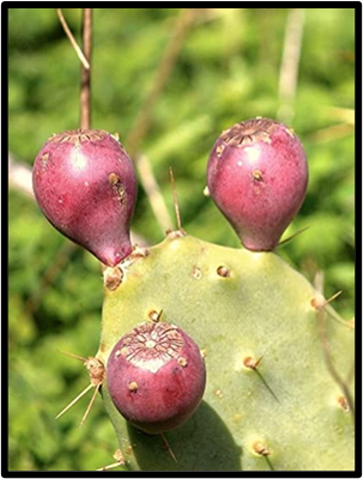
Prickly Pear
On either side of the pathway down to the pond, you will see the Prickly Pear Cactus, which is Bermuda’s only native cactus. It has bright yellow flowers in the summer and autumn and produces an edible red fruit. The spines are actually a special type of leaf, which help the cactus retain water so they can live in dry areas.
Return

Slide 29
Asparagus Fern
On the hillside is the low growing invasive Asparagus fern, which is not a true fern, but is often seen as a ground cover particularly in shady areas.
Did you know? Ferns first appeared on earth about 360 million years ago. In fact, ferns are older than dinosaurs!
Return

Slide 30
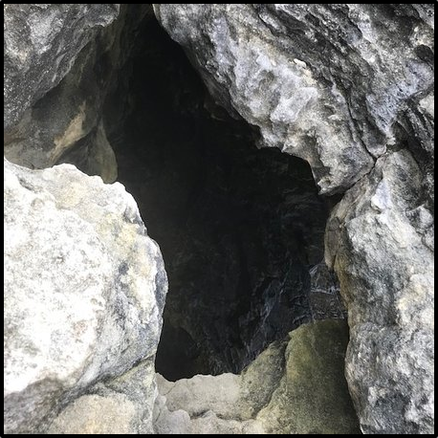
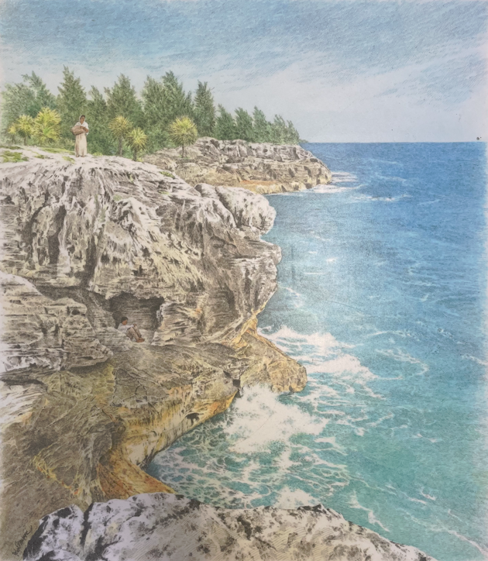
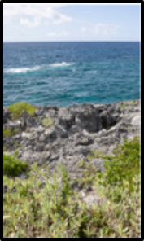
STATION 5 – JEFFREY’S CAVE
Watch Trey Maybury, graduate of Maryland tell the story of an enslaved man called Jeffrey who escaped from his enslaver. CLICK HERE FOR VIDEO.
Look at this photograph.
Q: Why do you think this was such a good hiding place for Jeffrey?
This is a picture looking down into the cave.
Q: What do you think life was like for Jeffrey during the time he spent in the cave?
Click here for Station 6
Painting by John Burgoyne

Slide 31
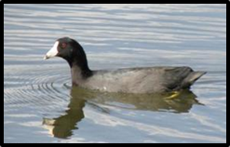
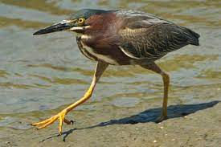
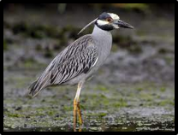
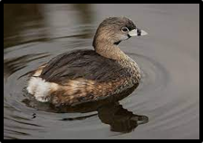
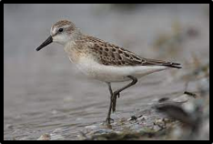
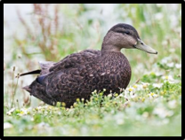
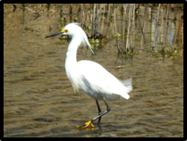
STATION 6 – LARGE POND: BIRDWATCHING
Watch Miguel Mejias, PhD student at College, and learn all about birdlife at Spittal Pond. CLICK HERE FOR VIDEO.
The Audubon Society is a charity that promotes the conservation of bird life and their habitats. The smaller round pond, which you will see from this station, is a freshwater pond and attracts many local and migrating birds. Below are pictures of just some of the birds at Spittal Pond. Click on a picture to find out about each bird. Q: How many did you spot?
Click here for Walking to Station 7

Slide 32
American Coot
The American Coot is a native water bird that can be found in freshwater and brackish water ponds and marshes island-wide. It is also often seen on golf courses and occasionally in fields and lawns. These birds are often seen in pairs or groups.
Coots are large dark coloured, duck-like birds. Adults have a black head and neck and black or charcoal gray bodies. Younger birds are lighter gray and become darker with age. Coots have a distinctive white bill and the white colour continues onto the forehead, between the birds red eyes. The coot also has a distinct white patch under its tail which can be seen as the bird swims away. When swimming Coots bob their head forwards and backwards. They will dive for food or dabble at the surface.
Return

Slide 33
Green Heron
Compared with most herons, Green Herons are short and stocky, with relatively short legs and thick necks that are often drawn up against their bodies. They have broad, rounded wings and a long, daggerlike bill. They sometimes raise their crown feathers into a short crest.
From a distance Green Herons look all dark. In better light they are deep green on the back with a rich chestnut breast and neck. The wings are dark grey. Juveniles are browner, with pale streaking on the neck and spots on the wings. Green Herons live around wooded ponds, marshes, rivers, reservoirs, and estuaries. Green Herons stand motionless at the water’s edge as they hunt for fish and amphibians.
Return

Slide 34
Yellow-crowned Night Heron
The most common heron in Bermuda. This medium sized heron can be seen during the day fishing from coastal rocks or docks. At night they can be seen hunting for land crabs in coastal forests or on beaches. They are also frequently seen in lawns and gardens where they catch a variety of prey including insects, whistling frogs and lizards. The adult Yellow-crowned Night Heron has a light grey body with a black head and a very prominent orange eye.
Return

Slide 35
Pied-billed Grebe
The pied-billed grebe is a common winter resident and migrant in Bermuda, although they are rarely seen flying. They usually inhabit freshwater ponds, quiet streams, and marshes. They may be also found in brackish marshes around particularly from mid-September through March. They travel as single birds or in small groups, frequently diving for food. Pied-billed grebes are very wary of any prey and quickly submerge when disturbed.
Return

Slide 36
Sandpiper
There are lots of different types of sandpiper. These birds forage on mudflats, picking up food by sight and feel (bill). They mainly eat aquatic insects and crustaceans. They are long distance migrants and winter in coastal South America, with some going to the southern United States, the Caribbean and Bermuda. They migrate in flocks which can number in the hundreds of thousands.
Return

Slide 37
American Black Duck
American Black Ducks are large ducks with rounded heads, thick bills, and bulky bodies. Like other dabbling ducks they sit high in the water with their tails high. These are dabbling ducks that tip up instead of dive when they forage. They eat aquatic plants, invertebrates, and occasionally small fish in shallow water. They also fly into agricultural fields to feed on waste corn and grain. Look for them mixed into flocks with other “puddle ducks” like mallards. They nest in wetlands including freshwater and saltmarshes. During migration and winter, they rest and forage in protected ponds, marshes, and bays.
Return

Slide 38
Snowy Egret
The snowy egret is a small white heron. At one time, the plumes of the snowy egret were in great demand as decorations for women's hats. They were hunted for these plumes, and this reduced the population of the species to dangerously low levels. It is now protected in the United States by law, under the Migratory Bird Treaty Act.
The snowy egret breeds in coastal and inland wetlands, and it generally prefers an environment of shallow water inlets for feeding purposes. Salt-marsh pools, tidal channels, shallow bays, and mangroves are among the most preferred habitats. They most live among coastal areas and islands due to the availability of food sources. During the winter months, egrets migrate to Bermuda to nest and roost in the mangroves.
Return

Slide 39
Northern Shoveller
Northern shovelers feed by dabbling for plant food, often by swinging its bill from side to side and using the bill to strain food from the water. Their wide-flat bill has a small, comb-like structures on the edge that act like sieves, allowing them to skim crustaceans and plankton from the water's surface. Mud-bottomed marshes and ponds, just like Spittal Pond, are their favourite habitat.
The shoveler prefers to nest in grassy areas away from open water. Their nest is a shallow depression on the ground, lined with plant material and down. Hens typically lay about nine eggs. The drakes are very territorial during breeding season and will defend their territory and partners from competing males.
Male
Female
Return

Slide 40
Hooded Mersangers
Hooded Mergansers are small ducks with a thin bill and a fan-shaped, collapsible crest that makes the head look oversized and oblong. In flight, the wings are thin, and the tail is relatively long and rounded. Adult male Hooded Mergansers are black above, with a white breast and rich chestnut flanks. The black head has a large white patch that varies in size when the crest is raised or lowered, but you can always see it. Females and chicks are gray and brown, with warm tawny-cinnamon tones on the head. They live on small bodies of freshwater. In summer, they nest in holes in trees, often near freshwater ponds or rivers. For winter, they move to larger bodies of freshwater, marshes, and protected saltwater bays.
Return

Slide 41
Blue-winged Teal
Blue-winged teals visit small freshwater lakes, swampy lakes, quiet rivers and small streams in open area. In winter it lives on
large shallow water surfaces, including marshes and rice fields, salt and brackish waters and swamps.
The blue-winged teal forages at water surface by dabbling into the shallow vegetation. Sometimes, it plunges the head into the water while it topples its body with the tail above the surface. It is rarely submerged under water and dives very occasionally. It often feeds at night and can be found in flocks of up to 30-40 birds.
Return

Slide 42
Walking to Station 7
Activity: On your walk to Station 7, see if you can spot any of these plants. Click on the pictures to find out more about each one.
Activity: Every so often, stop and have your child choose a sense. See how many different sounds they can hear: wind in the treetops, birds, insects, traffic, people and animals. Experience various feelings: wind on your skin, sun on your back. Remind them that we cannot always use taste, but we can imagine what the jam from berries would taste like. You can get children to wipe their fingers on a leaf near the ocean and taste the salt vs a leaf further in the park with (fresh water) morning dew on it.
Click here for Station 7

Slide 43
Natal Plum
Along the path we will also encounter the Natal Plum. This plant bears a fruit that’s edible when it matures to a deep red color; the rest of the plant is poisonous. Around the island, it grows densely and commonly used as hedges as the sharp, thorny branches make an impenetrable barrier.
Return

Slide 44
Maiden-Hair Fern
If you look carefully to your left on the shaded rock face, you will find the delicate, endemic Maiden-Hair Fern. Usually, it can be seen growing out of walls and at cave mouths and in most damp, shaded rocks and cliffs. It can vary greatly in size depending on how good the growing conditions are. Instead of flowers and seeds, all ferns produce spores, which can look like black spots on the back of these leaves.
Return

Slide 45
STATION 7 – THE CHECKERBOARD AND ROCKY SHORE
Activity: Before you watch the video, how do you think the checkboard was formed?
Once you have an idea, watch Dr Robbie Smith, who is the Curator at Bermuda Aquarium Museum and Zoo, talking about why the checkboard formation is such a special place and what it can tell us about Bermuda’s ancient past. CLICK HERE FOR VIDEO.
Check for Understanding:
The checkerboard formation was formed through erosion along the lines of weakness, or joints, in a very hard layer of Belmont marine limestone.
Next slide

Slide 46
Walk to Station 8
Activity: On your walk to Station 8, see if you can spot any of these plants and animals. Click on the pictures to find out more about each one.
Click here for Station 8

Slide 47
Beaded Periwinkles
Keep a lookout for the tidal pools here which contain tiny snails called beaded periwinkles. They can be hard to find since their colour provides a camouflage to help them blend into their environment.
Return

Slide 48
Red Land Crab
As you keep moving west, look for crab holes belonging to the red land crabs. These crabs are nocturnal and live underground in order to minimize water loss.
Q: Does anyone know what ‘nocturnal’ means?
A: Nocturnal means at active at night.
Look out for land hermit crabs which are being re-introduced in this area.
Return

Slide 49
Fiddlewood Tree
Further into the forested path, we can find a lot of Fiddlewood trees. The fiddlewood originally ranged from tropical America to Argentina and now is widely spread throughout the island. The leaves turn a golden-orange in early summer.
Q: Do you have any fiddlewood trees in your neighbourhood?
Return

Slide 50
Allspice Tree
There are also many Allspice Trees in this area. They are native to Jamaica, Cuba and Central America.
Sensory Activity: Smell the leaves. What do they remind you of?
Sensory Activity: Feel the trunk. How are the trunks of these trees different to the other ones?
Sensory Activity: Keep walking towards Station 8. As you round the corner, what can you smell?
Return

Slide 51
STATION 8 – THE DAIRY FARM
You are at the last station! Take a seat and listen to Dr Jonathan Nisbett, Bermuda’s Chief Veterinary Officer, tell us about the cows and their role in Bermuda’s agriculture. CLICK HERE FOR VIDEO.
Activity: Once you have finished watching the video, answer these two questions:
How much milk are Bermuda’s cows producing?
Which milk comes from local cows?
Activity: Buying Local Produce
Why is it a good idea to buy local produce?
What do you buy locally?
Do you know where we get our bananas from in Bermuda? (Ecuador and Costa Rica). Imagine how far away that is to get here, when we have our own bananas growing right here!
Next slide

Slide 52
ON YOUR WAY TO THE END...
We hope you enjoyed your Nature Walk today and learned something new about Spittal Pond. We are so very lucky to have this open space to enjoy, so please remember do not leave any litter behind.
We would like to sincerely thank our sponsor, Arch Re, for their continuing support of this annual event. We would like to give a special thanks to the wonderful presenters who agreed to be filmed for this presentation – we are very grateful to you all.
The Bermuda National Trust works hard to protect and preserve open spaces for the public to enjoy. As a charity, we cannot do this without your support. Your support shows how much you care about the important work we do in our open spaces, historic buildings and museums. It also helps us to educate Bermuda’s children about the island’s natural and cultural heritage.
Visit our website at www.bnt.bm to find out more details, or to please make a donation.
Thank you!
Sources of information

Slide 53
Sources of information
Website links:
www.bnt.bm
https://www.audubon.bm/birding/bermuda-birds
https://www.wikiwand.com/en/List_of_birds_of_Bermuda
https://www.allaboutbirds.org/guide
https://environment.bm
Photography:
Cover with kind permission of Emille Cossette
Alison Copeland
The Royal Gazette

